Slide 1
IBM University Engagement Project Submission
“Exploring the Power of Agentic AI with IBM Granite and IBM Bob”

Slide 2

Project Tile – Customer Data & Review Prediction
Domain of Project – MARKETING
Faculty Name | Recent Passport Photo | Email ID | Mobile number [WhatsApp]
Ms.M.Prasanna |  | prasannamatsa07@gmail.com | 8008019899

Slide 3
Problem Statement
Predict the customer rating (1–5 ⭐) for an e-commerce order based on customer demographics, order details, browsing behaviour, and delivery information.
This is a multi-class classification problem solved using scikit-learn pipelines trained on a real Turkish e-commerce dataset of customer transactions.

Slide 4
Proposed Solution
Proposed Solution: E-Commerce Customer Rating Predictor
Approach: Build an end-to-end supervised ML classification pipeline that learns patterns from historical order and session data to predict customer satisfaction ratings (1–5).
Key Steps:
Data: Real e-commerce dataset (14 features → Age, City, Product Category, Payment Method, Delivery Time, etc.)
Preprocessing: Median imputation + StandardScaler (numeric) · Ordinal Encoder (categorical)
Models Compared: Random Forest · Gradient Boosting · Extra Trees · Logistic Regression · KNN
Best Model Selected: Automatically chosen by highest test-set accuracy via 5-fold cross-validation
Deployment: Streamlit web app where users input order details and receive an instant predicted rating with class probabilities
Expected Outcome: A deployable, interactive web application that helps e-commerce businesses proactively identify low-satisfaction orders and improve customer experience before reviews are submitted.
P

Slide 5
Technology Used
IBM Bob platform -For designing and orchestrating multi-agent workflows visually
IBM Granite model - for eg – ibm-granite-3-2-8b – For natural language understanding, reasoning, and personalization
IBM Cloud – It provides the infrastructure to build, deploy, and scale the Nutrition Agent efficiently. IBM Cloud enables a reliable, secure, and scalable environment for customer data and rating predictor

Slide 6
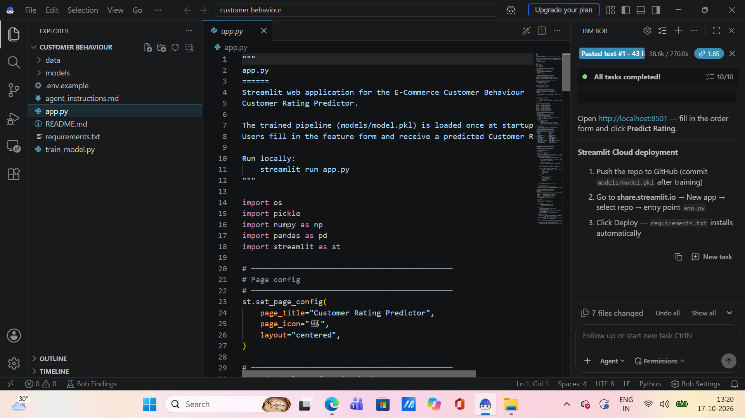
Required Files created using IBM bob -
App.py
Requirements.txt
Style.css
.env
Index.html

Slide 7
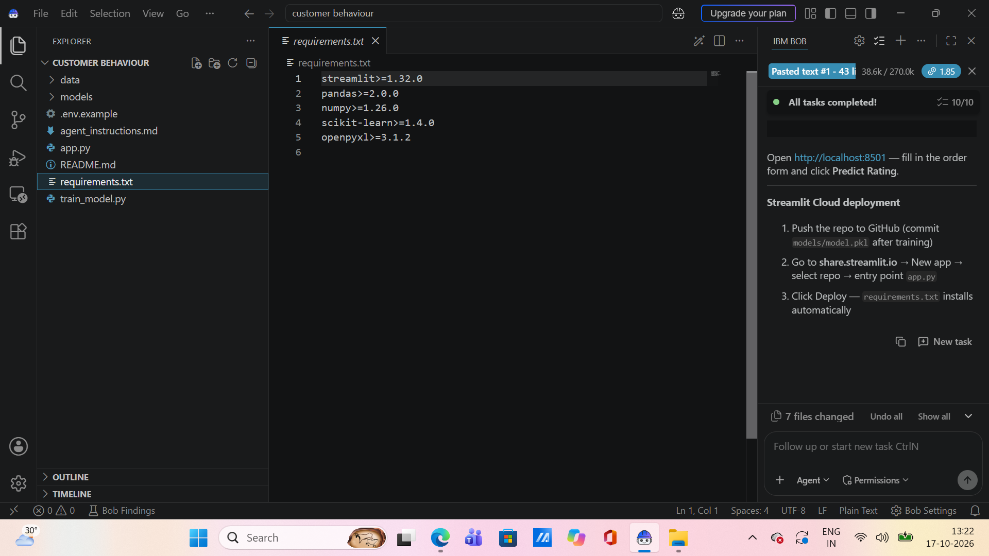
IBM Bob Screenshots:

Slide 8
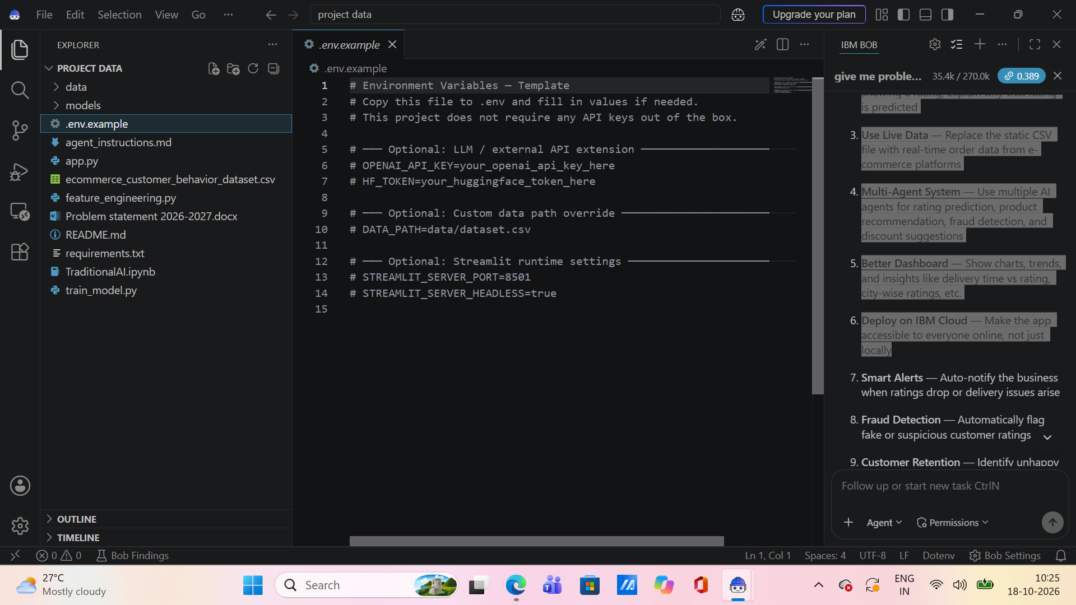

Slide 9
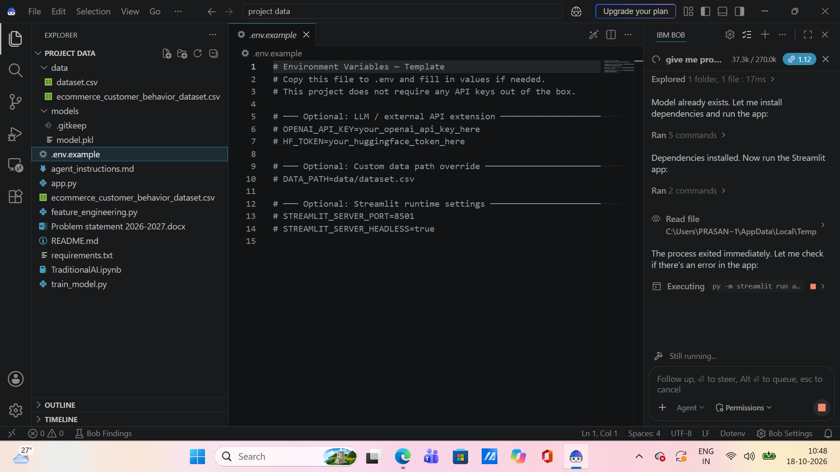

Slide 10
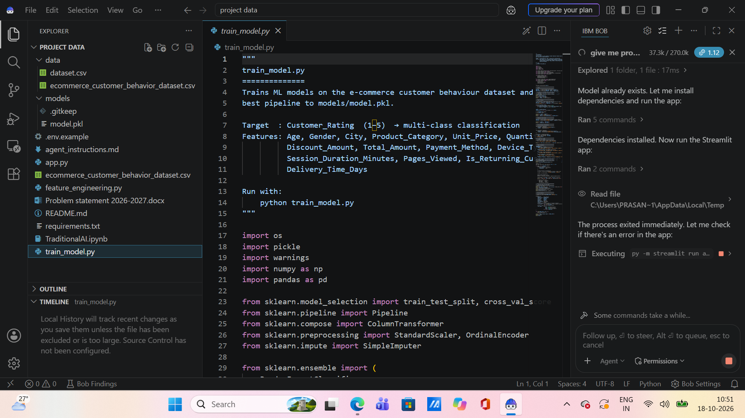

Slide 11
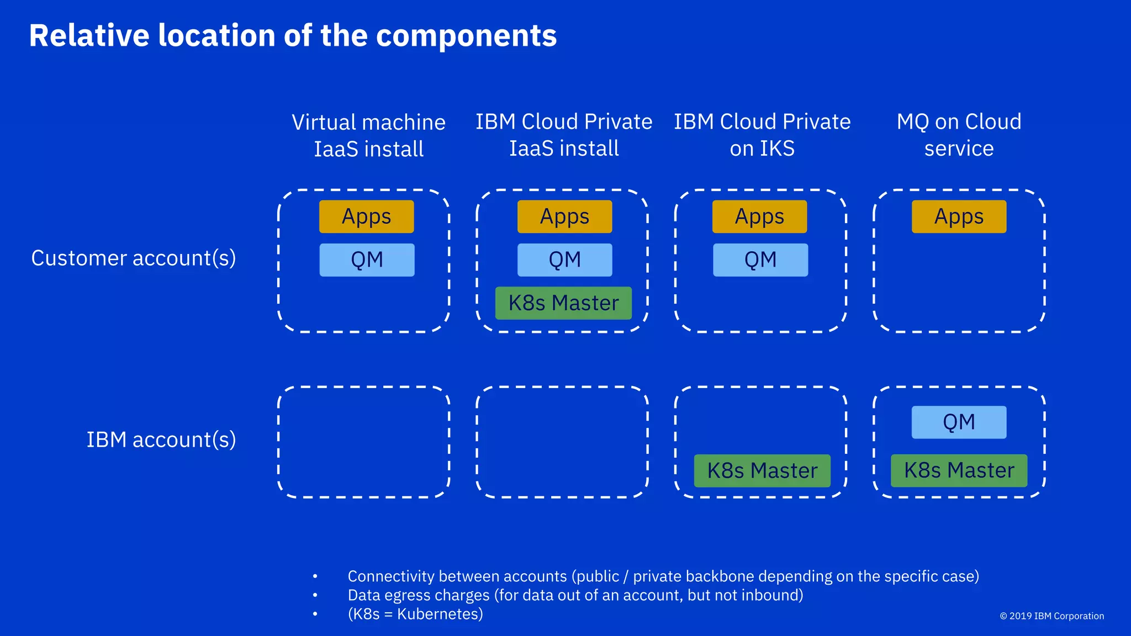
Architecture blueprint for IBM bob:

Slide 12

Role of Agentic AI in the solution
Agentic AI is an AI system that can understand a goal, make decisions, plan steps, and take actions automatically with limited human guidance.
In customer data management, Agentic AI helps companies collect, analyze, understand, and use customer information to improve customer satisfaction and business performance.
For example, an online shopping company uses Agentic AI to identify customers who may stop buying and automatically send them personalized offers.

Slide 13
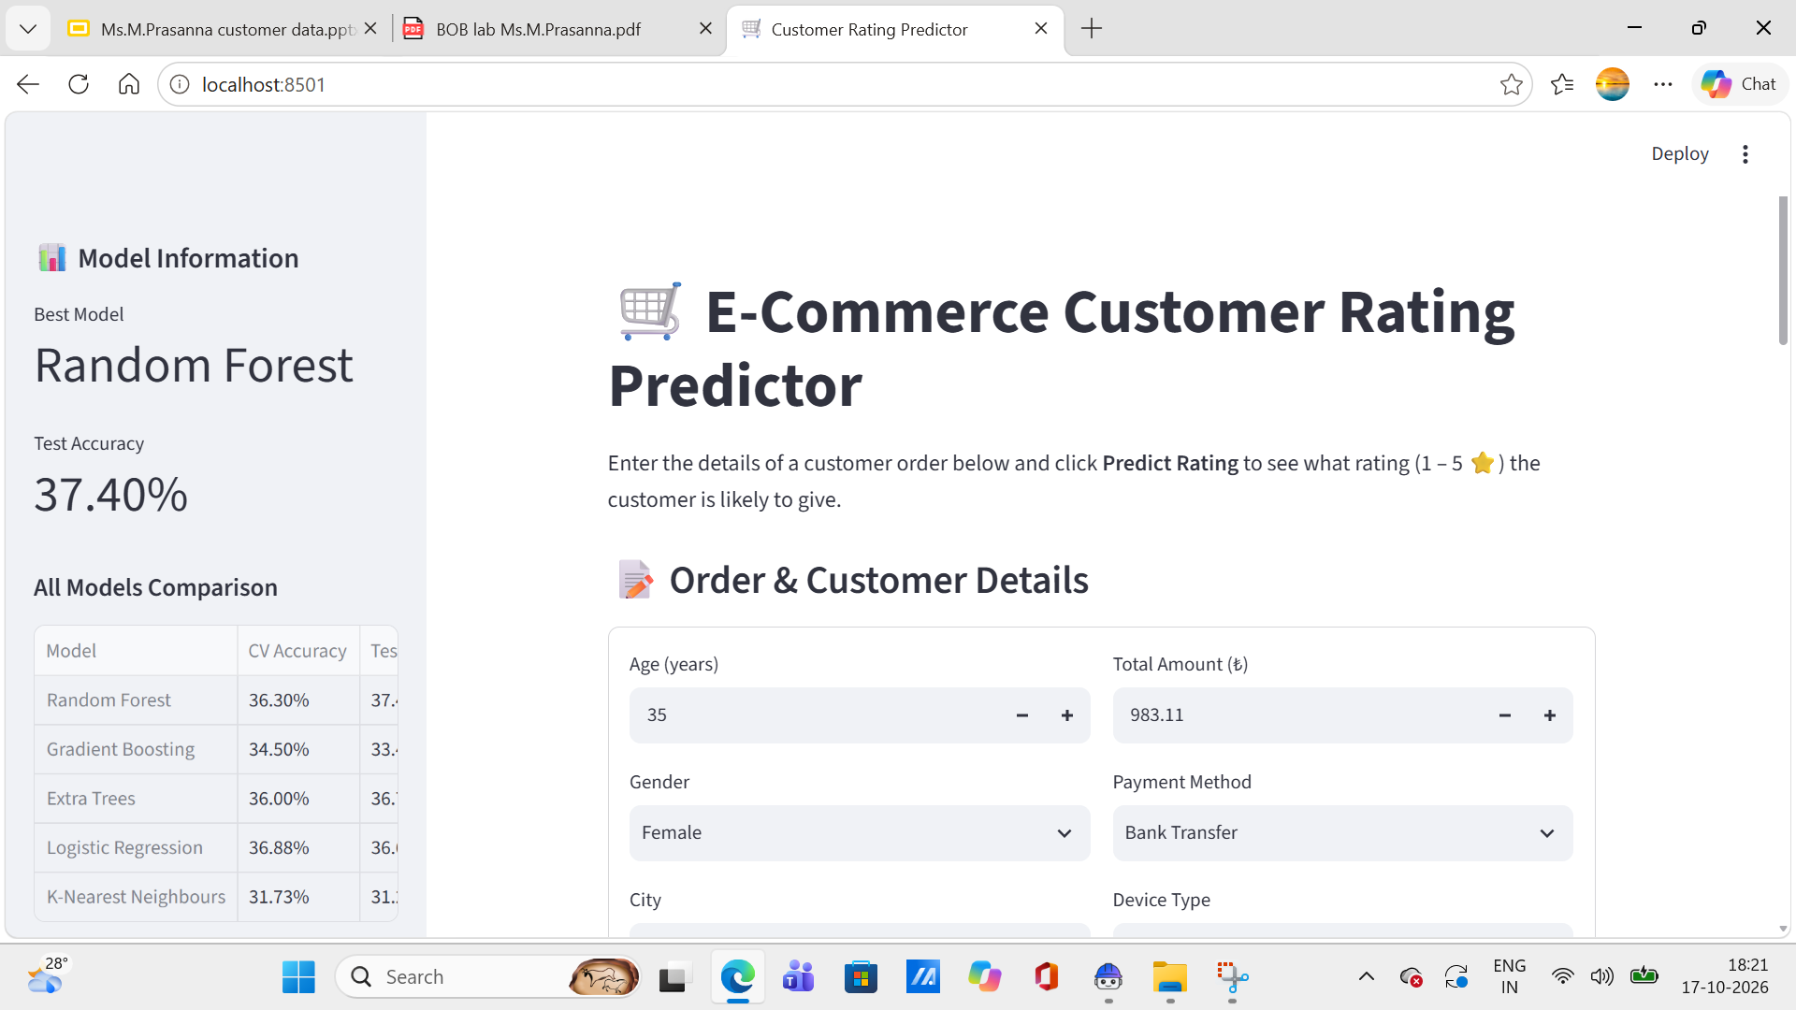
Project Output Screenshot
Please put IBM Bob output screenshots with 2-3 prompts.
You can take 2-3 more slides for each screenshot
·
·
·

Slide 14
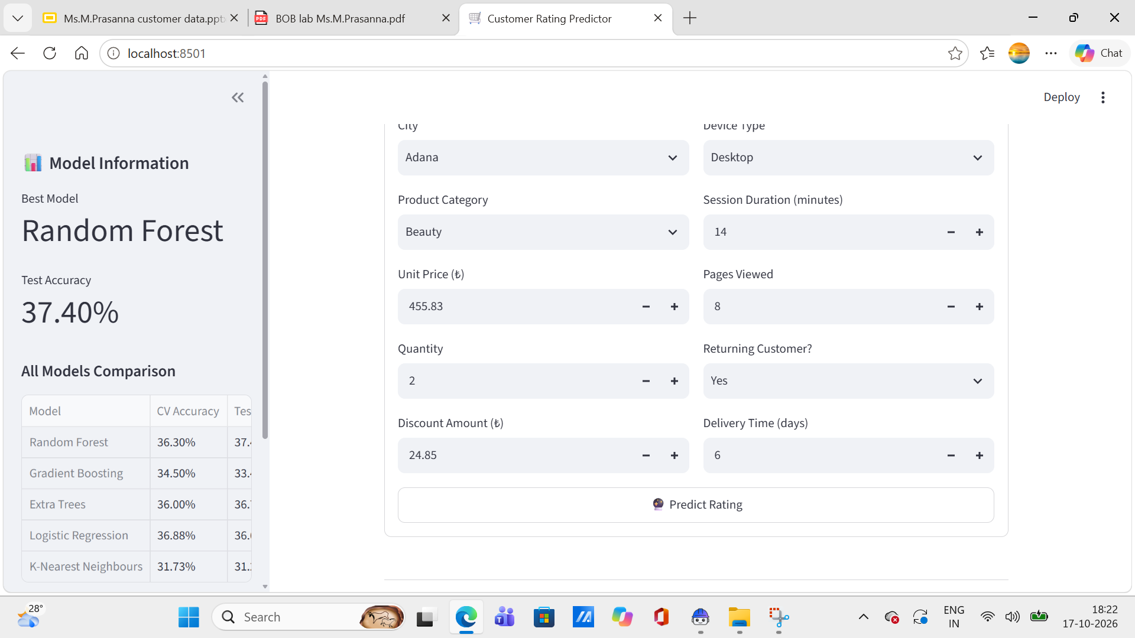
Project Output Screenshot
Please put IBM Bob output screenshots with 2-3 prompts.
You can take 2-3 more slides for each screenshot
·
·
·

Slide 15
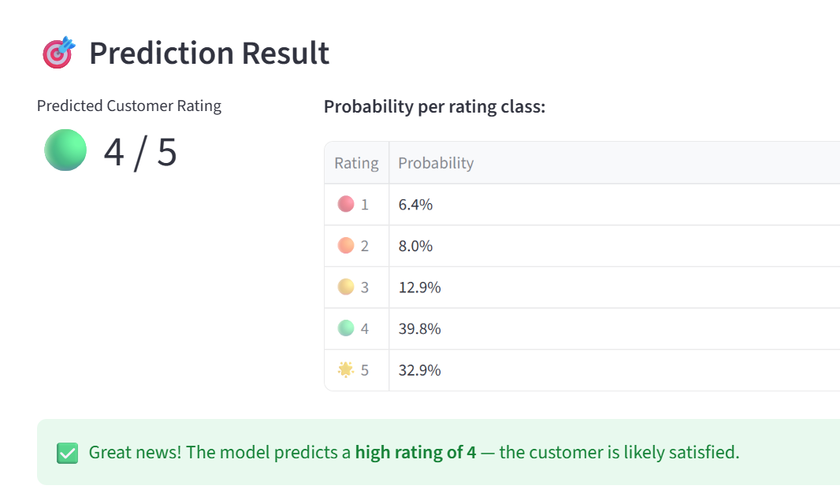
Project Output Screenshot
Please put IBM Bob output screenshots with 2-3 prompts.
You can take 2-3 more slides for each screenshot
·
·
·

Slide 16
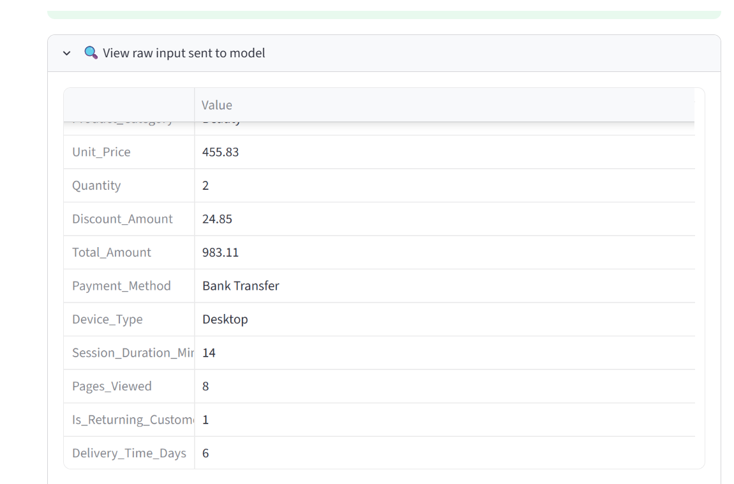

Slide 17
Novelty and Uniqueness
This project stands out from conventional machine learning applications in several important ways. Unlike typical ML projects that rely on a single pre-chosen algorithm, this system automatically trains and evaluates five different classification models — Random Forest, Gradient Boosting, Extra Trees, Logistic Regression, and K-Nearest Neighbours — and intelligently selects the best performing one based on actual test accuracy. This automatic model selection mechanism ensures that the most optimal algorithm is always used without any manual intervention.
The evaluation methodology is equally robust. Each model is assessed using both 5-fold cross-validation on the training set and a separate test set accuracy score, providing a two-layer validation that prevents overfitting and ensures reliable, unbiased results. This dual evaluation approach is rarely seen in beginner to intermediate level ML projects, making this system more trustworthy and production-ready.

Slide 18
Git Hub Link
https://github.com/prasannamatsa07-cyber/CUSTOMER-DATA-RATING-PREDICTION.git
·
·
·

Slide 19
Future Scope
Add AI Chatbot — Let users ask questions and get answers in simple language using IBM Granite
Explain Predictions — Instead of just showing a rating, explain why that rating is predicted
Use Live Data — Replace the static CSV file with real-time order data from e-commerce platforms
Multi-Agent System — Use multiple AI agents for rating prediction, product recommendation, fraud detection, and discount suggestions
Better Dashboard — Show charts, trends, and insights like delivery time vs rating, city-wise ratings, etc.
Deploy on IBM Cloud — Make the app accessible to everyone online, not just locally
·
·
·

Slide 20
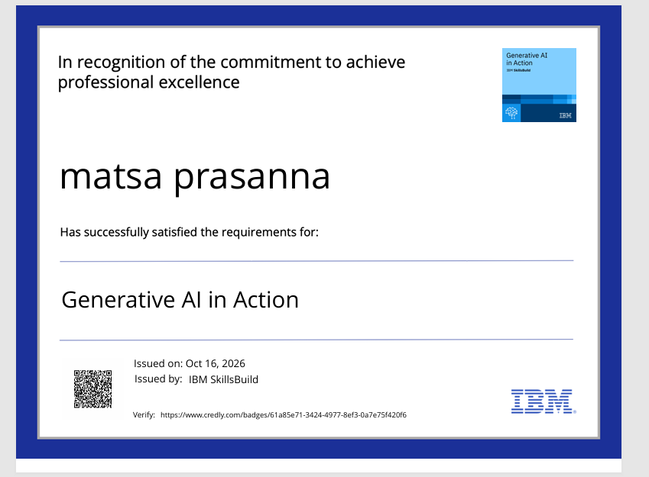
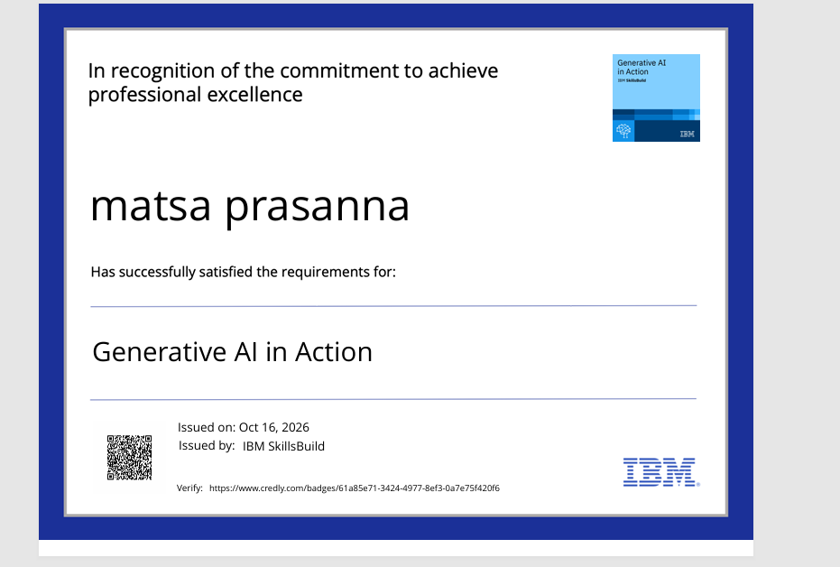
Certificates Earned:
Please add your credly certificate

Slide 21
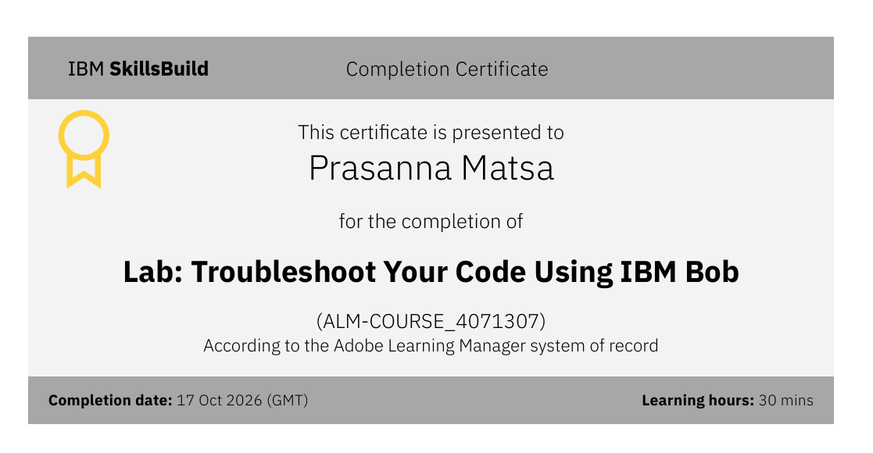
Certificates Earned:​
Add your IBM BOB Certificate

Slide 22


